Slide 1




A case study on employer’s engagement in coursework
Dr Malgorzata Wojtys (Gosia)
University of Plymouth
30 June 2022
IMS/RSS Higher Education Teaching and Learning Series

Slide 2
Context
2nd year BSc (Hons) Mathematics (and other maths programmes) at the University of Plymouth
Module: “Operational Research and Monte Carlo Methods”
Compulsory module, focused on employability skills
Module aims and learning outcomes
To develop practical skills that can be used directly in a workplace
To apply mathematics to solve real life problems
To improve students’ computer and programming skills
To refine students’ communication skills and cooperation with others through teamwork
To practice presentation skills

Slide 3
Assessed learning outcomes
“At the end of the module you will be expected to be able to:
solve particular problems in OR
demonstrate proficiency in using computer programming to solve particular problems in the field of Monte Carlo methods and modelling
demonstrate an awareness of personal proficiency in various key skills and the need to match career plans with these
co-operate with others in producing a piece of work
communicate the results of the analyses through oral presentations and written reports”

Slide 4
Assessed learning outcomes
“At the end of the module you will be expected to be able to:
solve particular problems in OR
demonstrate proficiency in using computer programming to solve particular problems in the field of Monte Carlo methods and modelling
demonstrate an awareness of personal proficiency in various key skills and the need to match career plans with these
co-operate with others in producing a piece of work
communicate the results of the analyses through oral presentations and written reports”

Slide 5
Assessed learning outcomes
“At the end of the module you will be expected to be able to:
solve particular problems in OR
demonstrate proficiency in using computer programming to solve particular problems in the field of Monte Carlo methods and modelling
demonstrate an awareness of personal proficiency in various key skills and the need to match career plans with these
co-operate with others in producing a piece of work
communicate the results of the analyses through oral presentations and written reports”

Slide 6
Assessed learning outcomes
“At the end of the module you will be expected to be able to:
solve particular problems in OR
demonstrate proficiency in using computer programming to solve particular problems in the field of Monte Carlo methods and modelling
demonstrate an awareness of personal proficiency in various key skills and the need to match career plans with these
co-operate with others in producing a piece of work
communicate the results of the analyses through oral presentations and written reports”

Slide 7
Module structure
Module contents:
Risk analysis (weeks 1-6), using MS Excel
Queuing systems (weeks 7-12), using SIMUL8
Series of tasks on Monte-Carlo methods using Python and reflective report on employability skills (weeks 1-12)
Assessments:
100% Coursework, no exam
Report, presentation, portfolio
A “hands-on” module: students work independently on open-ended case studies to develop these skills

Slide 8


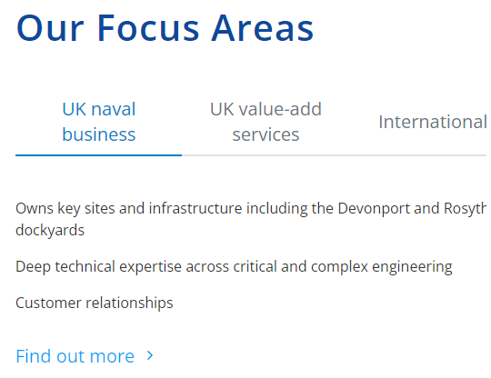
The employer
Babcock Intl. (www.babcockinternational.com)
International aerospace, defence and security company.
Notes:
Who is the employer? Babcock Intl.
Merv, Callum – UoP graduates
Relationship kept for a number of years
They are local, have placement programmes, recruit our students regularly
invited to employers advisory panel, poster showcases, careers days

Slide 9
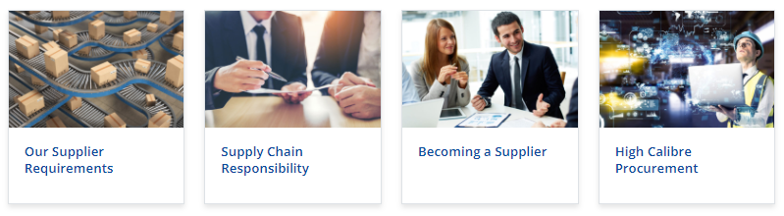
The employer
Members of External Advisory Panel
UoP graduates
Present at job fairs, project showcases, etc.
Supply chain management
Notes:
Who is the employer? Babcock Intl.
Merv Pengelly, Callum Springard – UoP graduates
Relationship kept for a number of years
They are local, have placement programmes, recruit our students regularly
invited to employers advisory panel, poster showcases, careers days

Slide 10
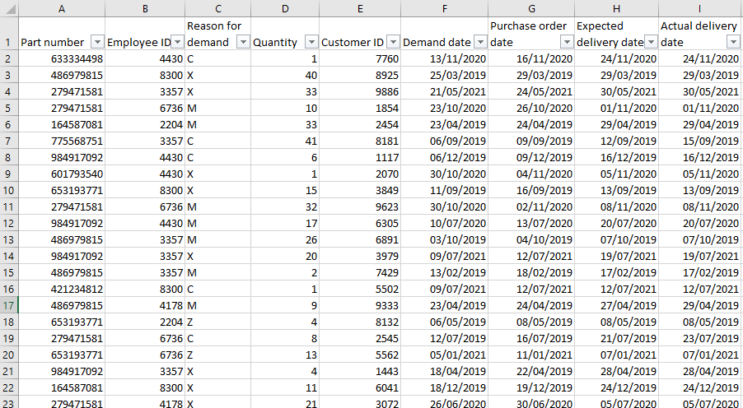
Coursework tasks
Database of items held in warehouse
Mimicking real data - confidentiality
Notes:
A mixture of open-ended questions and detailed instructions

Slide 11
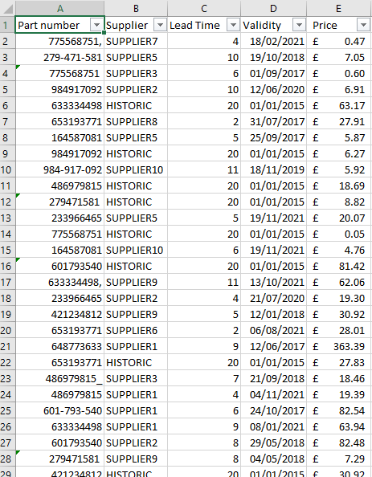
Coursework tasks
Data cleansing
Assess quality
and reliability of data sources
Collate data sources
to create reliable information
Investigate the pattern
of demands/costs over years
Notes:
Errors in data entries; some prices expressed in dollars – convert using the correct exchange rate;
Provide commentary: what assumptions did you make?

Slide 12
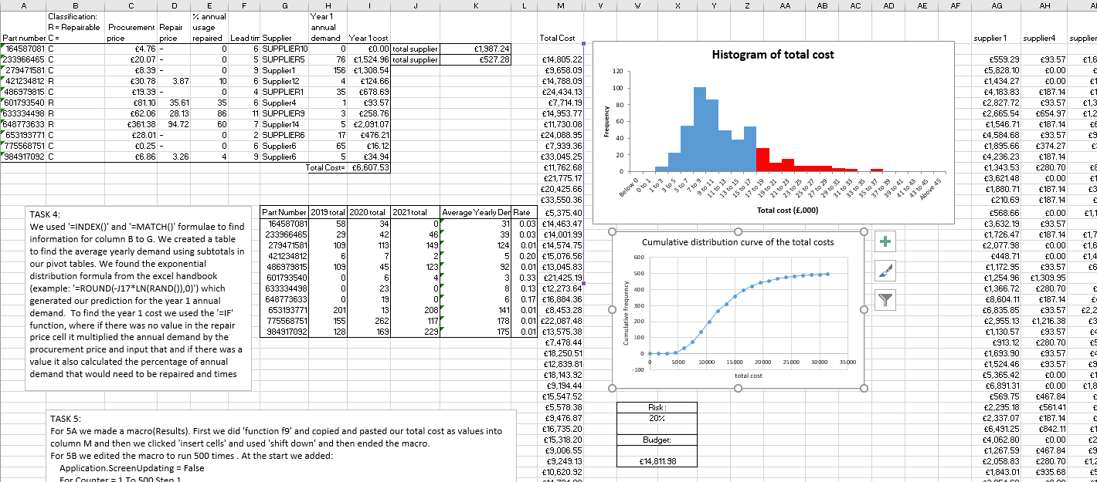
Coursework tasks
Forecast the demand and costs using simulations
Investigate the risk that the cost will exceed a given threshold.
Which supplier is responsible for the largest portion of the forecast cost? Etc…
Notes:
How much budget would be required to ensure the company can buy all the forecasted items for 70% of the scenarios?

Slide 13
Implementation
2 weeks of introduction: learn skills necessary for coursework
Random sampling in MS Excel
Writing macros and running simulations
Data cleansing
Pivot tables
Handbook to work through
4 weeks of independent work
including during weekly classes in computer rooms
Students work in groups of 3 or 4
Minutes. Marks are awarded for minutes.
Peer assessment.

Slide 14
Implementation
Employer’s visit in the first session
Formative feedback – during classes
Summative assessment: spreadsheet and written report.
Feedback to employer:
best submissions,
possible placements, …
Notes:
The idea is that this helps students to get a better feel of the problem and the practical importance of it, helps with motivation

Slide 15
Evidence and recommendations
Regarding module contents, aspects that stood out to students:
practical
real-world
software
relevant for employment
“The content was interesting and the skills learnt will be beneficial after the degree.”
“I loved the accent they put on employability and made sure we had plenty of opportunities for placements etc.”
“It was a very practical module which I enjoyed with a specific real life application.”
“The best aspect was learning how to use new software and techniques”
Notes:
The opinions that were repeated by many students are that they liked: (a) that the module was practical. (b) that the module content was related to real world applications. (c) the relevance for employability. (d) learning new software.
But:
“Felt it wasn’t entirely related to the course”

Slide 16
Evidence and recommendations
Regarding mode of delivery,
apprehensive about change
plenty of time for work
clear, practical handbook
“Module itself was very self-taught which was a change that took getting used to.”
“The research aspect was great. The fact that we got a module where it wasn't a "theory, practice, memorise, exam" style was very nice. It also gave a real feel for what real world work is like.”
“I liked the amount of contact time with tutors in the computer lab.”
“Workbooks on Excel and SIMUL8 were very useful and easy to follow.”
Notes:
The opinions that were repeated by many students are that students liked: (a) detailed and clear handbook on new software. (b) plenty of time in classes to work on CW. (c) Availability of lecturers during classes to answer questions and give feedback.

Slide 17
Evidence and recommendations
Regarding the coursework,
not always clear what to do,
enjoyable
“Interesting real-world case studies to look at and analyse”
“Thoroughly enjoyed trying to solve real-world problems”
“The best aspect was that it was coursework based module this was less stressful assessment method than exam”
“Risk analysis coursework could be made clearer as instructions seemed quite open ended and the quality of the spreadsheet was inconsistent.”
Notes:
The opinions that were repeated by many students are that students liked: (a) practical CW. (b) no exam.

Slide 18
Evidence and recommendations
Risk:
Students’ expectations not aligned with the purpose of the module.
Students confused, lost, stressed, overwhelmed.
Communication with students!
why we are doing this,
what they should expect.
With this, students appreciate the experience, enjoy it, benefit and consciously develop the skills.
Issues with peer assessment
Anonymous?
Notes:
It is of utmost importance to communicate to students very clearly and continually why we are doing this, what they should expect of us, what will be the benefit for them.
This is more important here than for other “usual” modules.
Without this, the module is a failure: students are confused, tutors are overwhelmed with questions, students do not benefit, it is stressful, chaotic experience, students have expectations that do not align with the purpose of the module.
With this, students appreciate the experience, they enjoy it, they benefit and consciously develop the skills
CW must end in good time before exams, not overlapping with revision for exams.

Slide 19
Thank you!

